Slide 1
Cardiovascular Disease Predictor
CS 6010 Project
Amr Ibrahim & Vlad Yashaev
Fall 2022

Slide 2
INTRODUCTION
Improve outcomes for patients at risk for CVD by using machine learning models to refine early detection
Cardiovascular diseases (CVD) are leading cause of death globally
17.9 million lives per year
Heart attacks and strokes account for 80% of CVDs
1/3 of which occur in people under 70 years old
Identifying people with CVD and those who are at high cardiovascular risk can prevent premature deaths
Logistic Regression
Random Forest
Prediction accuracy > 80%
Decision Tree
Support Vector Machine
K- Nearest Neighbor
World Health Organization. (n.d.). Cardiovascular diseases. World Health Organization. Retrieved November 5, 2022, from https://www.who.int/health-topics/cardiovascular-diseases#tab=tab_1

Slide 3
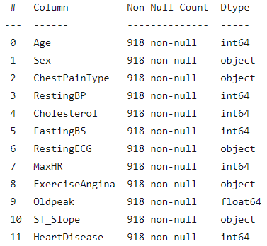
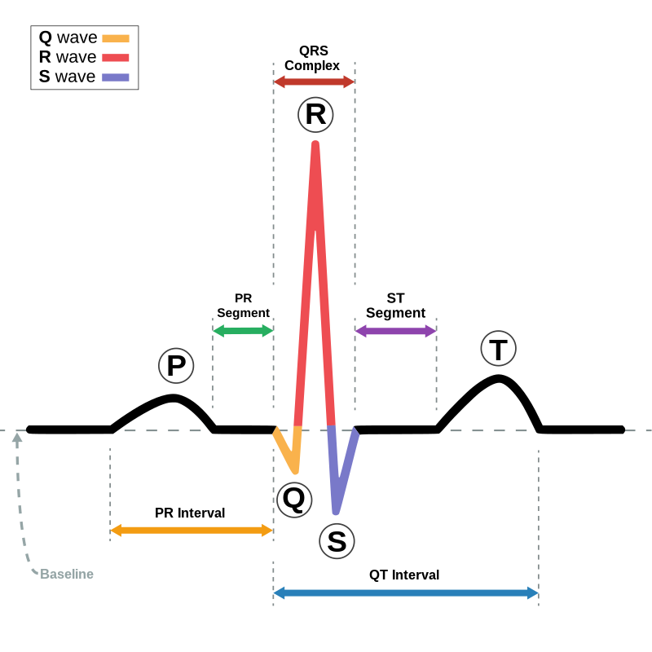
Data Description
Data was obtained from kaggle Heart Failure Prediction Dataset
CSV file with 12 features and 918 observations
Features included are
Numerical (int64 & float64)
Categorical (object)
fedesoriano. (September 2021). Heart Failure Prediction Dataset. Retrieved 11/05/2022 from
https://www.kaggle.com/fedesoriano/heart-failure-prediction.
“Electrocardiography.” Wikipedia, Wikimedia Foundation, 15 Nov. 2022, https://en.wikipedia.org/wiki/Electrocardiography.

Slide 4
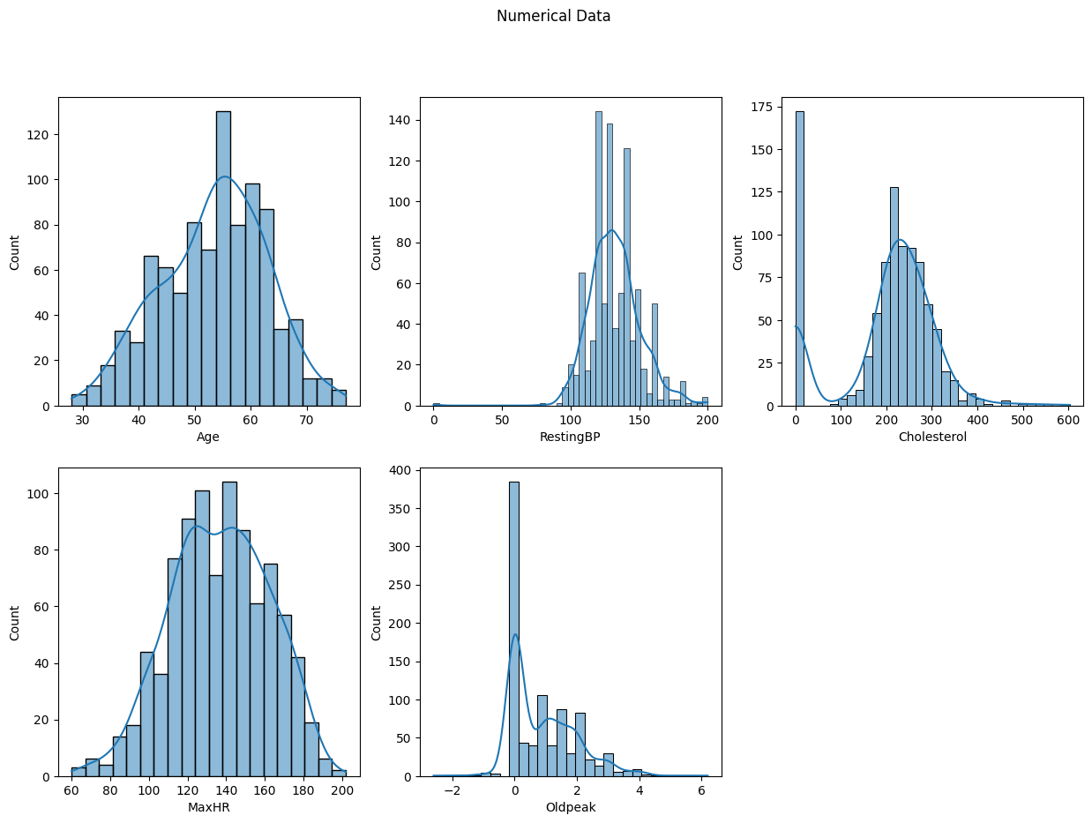
Numerical Data

Slide 5
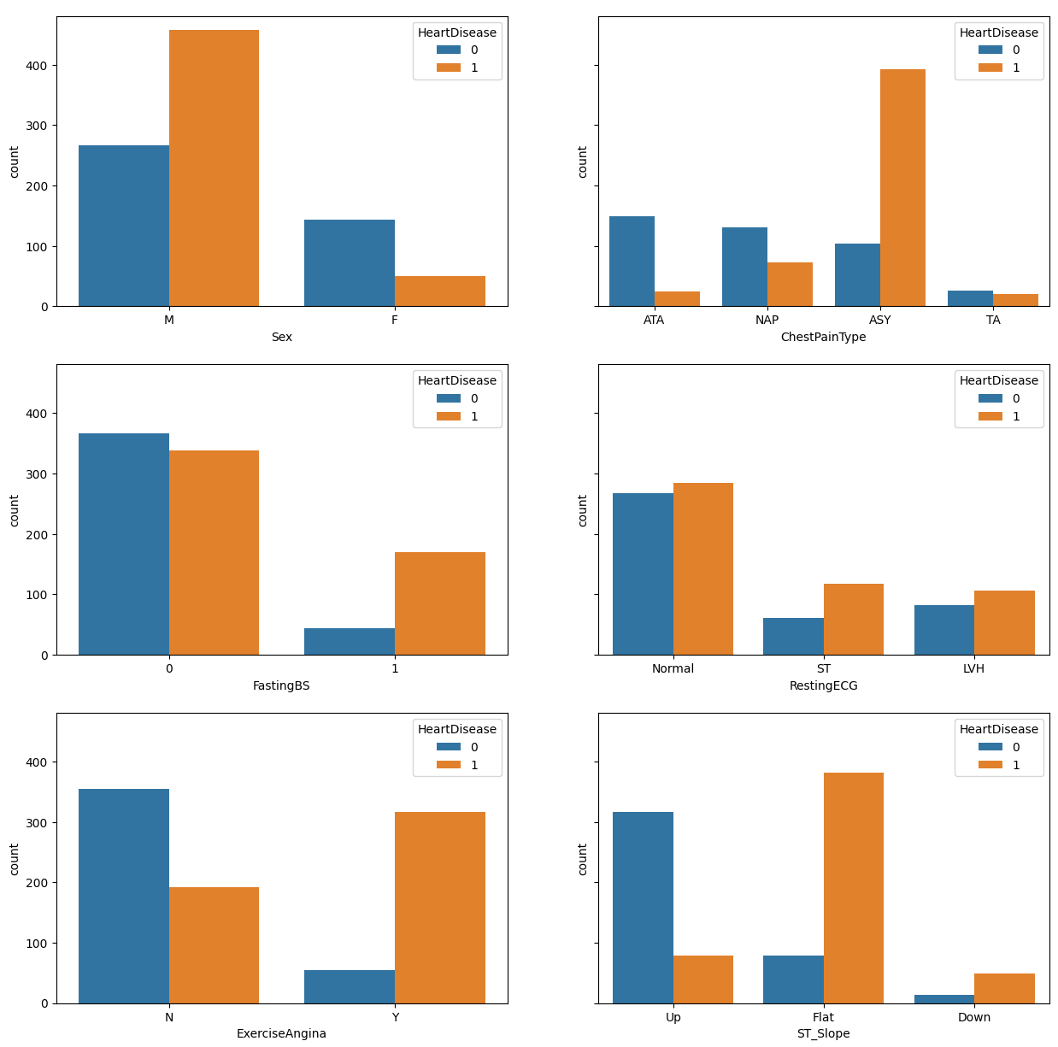
Categorical Data

Slide 6
Data Cleaning & Preprocessing
1
2
3
4
NA Values
Transformations
Outliers
Features
There were no NA values
All categorical variables were transformed into numerical
Rescale data to reduce effect of outliers
Evaluate features for possible dimensionality reduction

Slide 7
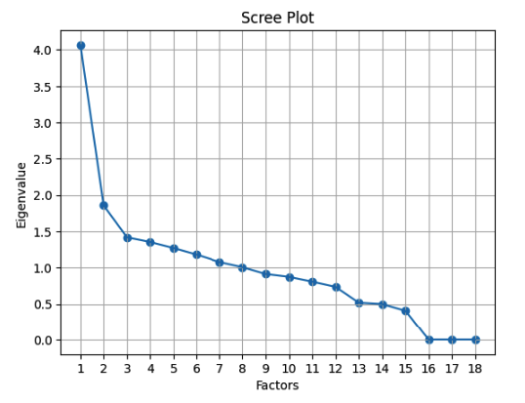
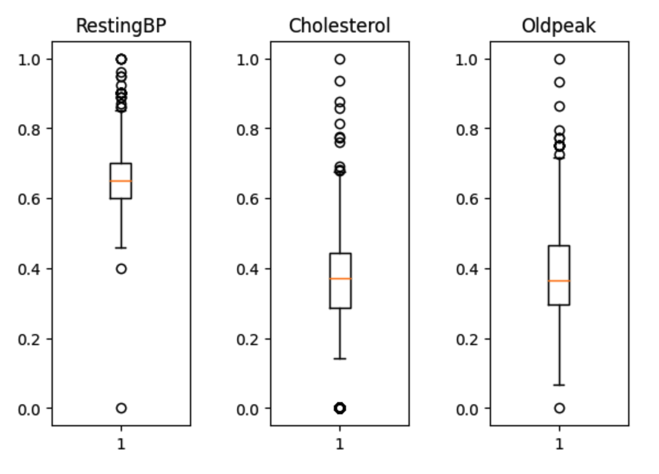
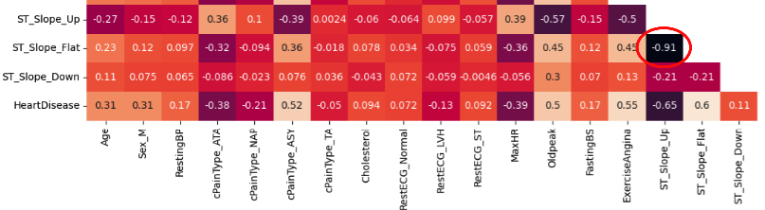
Outliers & Feature Analysis
Outliers
Created an Outliers() class with methods that
returns features with outliers
Mean, Q1, Q3, and IQR values
returns boxplots for outlier features
Determined not to remove outliers. Scaled data instead.
Feature Analysis
Scree plot / factor eigenvalues
first 8 factors with high eigenvalues accounts for only 73.55%
Remove ST_Slope_Flat - high correlation (0.92) with ST_Slope_Up

Slide 8

Modeling and Evaluation
Parameter Tunning (GridSearchCV)
LogisticRegression(C=100.0)
SVC(C=0.1, gamma=0.1)
RandomForestClassifier(max_depth=40, n_estimators=50)
KNeighborsClassifier(n_neighbors=11, weights='distance')
DecisionTreeClassifier(max_depth=5, min_samples_leaf=5)
Model Evaluation (Talk about your modelAverages function)
Function modelAverages(model, modelName, xTrain, yTrain, xTest , yTest)
Runs each model 50 times and returns averages for model accuracy, recall, precision, and F1 values

Slide 9
Evaluation
Model | Accuracy | Recall | Precision | F1 Score
Logistic Regression | 88.32 | 92.23 | 86.41 | 89.22
SVM | 88.04 | 94.82 | 84.33 | 89.27
Random Forest | 87.20 | 92.19 | 84.73 | 88.31
KNN | 85.87 | 89.64 | 84.39 | 86.93
Decision Tree | 85.87 | 92.34 | 82.72 | 87.25

Slide 10
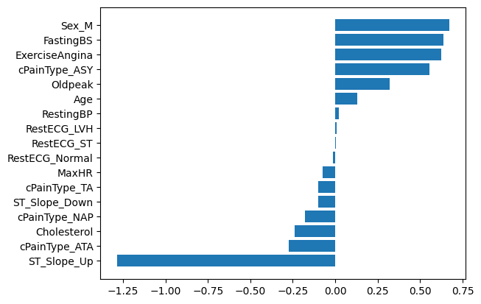
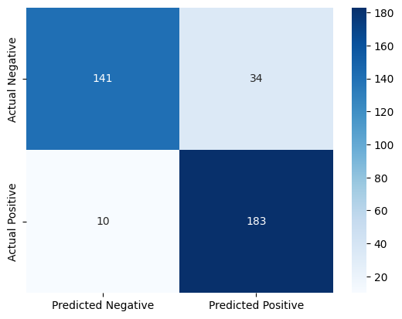
SVM
Feature Importance
Confusion Matrix

Slide 11
Discussion
Results may vary for each iteration of model fitting and target predicting.
Scaling data with outliers provides higher predictive accuracy.
With enough training data and further parameter tuning, machine learning can be useful tool in refining early detection of CVD.
Linear Regression performed the best on scaled data without outliers. However, for scaled data with outliers (i.e., more observations for the training data), SVM performed best.
What we learned:
Available resources exist to help figure out ideal parameter setting to increase accuracy metrics.
It is better to test multiple models as different models may perform better for different dataset.
It is important to clean up the data, then try different versions of the data for model training purposes
playing around with the number of features to retain.
Running the models on training data where outliers and/or NA values are handled differently.

Slide 12

Conclusion
Cardiovascular diseases (CVD) are the leading cause of death globally and early detection of CVD patients can prevent premature deaths.
With a relatively small training dataset, machine learning models can be trained to help in the early detection of cardiovascular diseases in patients.

Slide 13
Future Direction
Test models on new test data.
Evaluate accuracy of the models with less available features.
More statistical analysis on variations using averages vs not.
Review if the models performed better with outliers due to more observations or due to unique combinations of values in features.

Slide 14
THANKS!

